Slide 1
MACHINE LEARNING FRAMEWORK FOR IDENTIFICATION OF ABNORMAL EEG SIGNAL
BY
Dr. A. Prabhakara Rao,
Professor, Department of ECE

Slide 2
MACHINE LEARNING FRAMEWORK FOR IDENTIFICATION OF ABNORMAL EEG SIGNAL
BY
Dr. A. Prabhakara Rao,
Professor, Department of ECE

Slide 3
CONTENTS
Problem statement
Introduction
Methodology
Working
Results
Conclusion
References

Slide 4
PROBLEM STATEMENT
Epilepsy is a chronic non-communicable disease of the brain that effects people of all ages.
It may leads to seizures ,loss of awareness ,unusual sensations & behavior.
70% People with this disease could lead their life seizer-free if properly diagnosed & treated.
Visual examination of EEG signal by observing a change in frequency/amplitude in long duration signals is a difficult task. It may leads to inaccurate categorization.
Determination of epileptic seizure is essential task for the treatment of epilepsy.
So this project propose a ML Framework which consists of 7 classifiers to detect the abnormality in the EGG signal automatically.

Slide 5
INTRODUCTION
Epilepsy is central nervous system disorder in which brain activity becomes abnormal, causing seizures etc.
Around 50 million people worldwide have epilepsy, making it one of the most common neurological diseases globally.
Electroencephalograms are universally used to detect epilepsy accurately
Visual Examination of EEG is a little bit difficult.
So this project main goal is to detect the abnormality in EEG automatically which help in diagnosis and treatment of epilepsy.
Data was collected from Bonn dataset since wavelets are well localized in both Time & Frequency domains so we use wavelet tool box for feature extraction.
The extracted feature are fed to ML Framework for the classification of abnormalities

Slide 6
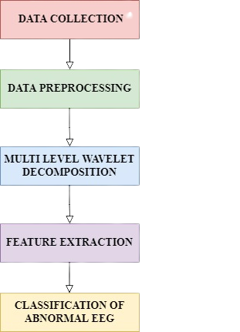
METHODOLOGY
WORK FLOW

Slide 7
We Collected Data From Bonn Dataset The Dimension Of The Dataset Are 1180×180 Which Consist Of 5 Outcomes 1 Represent Seizure,2 &3 Represent Tumor,4&5 Represent Healthy
DATA COLLECTION
DATA PREPROCESSING
We consider healthy record(4,5) and seizure record(2) and resample the records from 178.3Hz to 128Hz using bandpass filter and notch filter
MULTILEVEL WAVELET DECOMPOSITION
Using db4 wavelet we perform 4 level wavelet decomposition as result of it we get one approximation and 4 detail coefficients
The dimension of the each coefficient is 4097×100

Slide 8
FEATURE EXTRACTION
From decomposed dataset, we extracted mean, variance, skewness, kurtosis ,max_svd & entropy_svd .
CLASSIFICATION OF ABNORMAL EEG
The extracted features are fed to ML Framework,
For this Frame work we use 7 classification models to classify the abnormality
Support Vector Machine
KNN classifier
Decision Tree
Random Forest
AdaBoost
Logistic Regression
Bagging
We calculate performance of each classifier using Accuracy and AUC

Slide 9
WORKING
We have collected EEG data from Epileptic seizure Recognition dataset
The dimensions of the data is (1180 x180) and sample frequency of data is 178.6 Hz and time duration is 23.6 sec.
For our convenience we resampled our data to 128 Hz and time duration is same.
After resampling we have done 4 level wavelet decomposition for this data using db4 wavelet
As a result of this decomposition we got 5 coefficients from this data (1 approximate and 4 detail coefficients)
The dimension of each coefficient is (4097 x 100).
From each coefficient we extracted 6 features(mean, variance, skewness, kurtosis, max_svd, entropy_svd) and fed to ML Framework.
Performance of the ML Framework is calculated using Accuracy & AUC.

Slide 10
RESULTS
CLASSIFIER | ACCURACY | AUC
SVM | 0.48 | 0.48
KNN | 0.56 | 0.56
Decision Tree | 0.65 | 0.65
AdaBoost | 0.58 | 0.62
Random Forest | 0.68 | 0.75
Logistic Regression | 0.48 | 0.44
Bagging | 0.70 | 0.79
AUC – Area under the ROC curve ROC- Receiver Operating Characteristic Curve

Slide 11
CLASSIFIERS PERFORMANCE

Slide 12
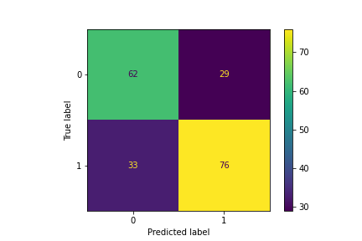
CONFUSION MATRIX

Slide 13
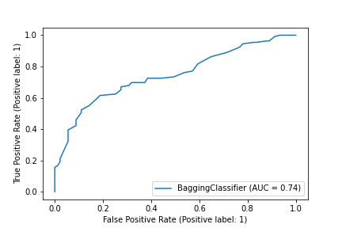
ROC CURVE

Slide 14
CONCLUSION
The main objective of this model is to aid the radiologist in diagnosis of abnormalities of the EEG.
So, we consider a ML Frame work with various classification algorithms to classify normal and abnormal EEG which represent seizure activity.
Out of all these Classification algorithms in our framework bagging classifier perform well with 70% accuracy and 79% AUC.
The propose model can reduce the workload on the radiologist who work on detecting seizures visually and manually on long-duration EEG signal
Since our framework model is simple and resourceful it can be used in a practice set up.
Thus, our framework will rectify the mis classification of abnormalities in the EEG signal.

Slide 15
Future Scope
This machine learning frame work can be used to other abnormalities like sleep disorder, neural diseases like Parkinson’s, Alzheimer’s, autism, etc.
Research work can be done to build a wearable device which predict the spontaneous abnormalities in the brain like seizures etc.

Slide 16
REFERENCES
M. Sharma, U.R. Acharya, Sohnam kumar Patel, Automated detection of abnormal EEG signals using localized wavelet filter banks ,pattern Recongnit.Lett.133(2020) 188-194,https://doi.org/10.1016/j.patrec.2020.03.009.
M. Sharma, R.B. Pachori, U.R. Acharya, A new approach to characterize epileptic seizures using analytic time-frequency flexible wavelet transform and fractal dimension, Pattern Recognit. Lett. 94 (2017) 172–179.
A. Bhattacharyya, R.B. Pachori, A multivariate approach for patient-specific eeg seizure detection using empirical wavelet transform, IEEE Trans. Biomed. Eng.64 (9) (2017) 2003–2015, doi:10.1109/TBME.2017.2650259.
M. Sharma, M. Raval, U.R. Acharya, A new approach to identify obstructive sleep apnea using an optimal orthogonal wavelet filter bank with ecg signals, Inform. Med. Unlocked (2019) 100170, doi:10.1016/j.imu.2019.100170.

Slide 17


